Slide 1
Constructors In C++

Slide 2
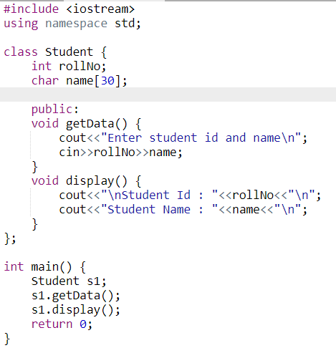
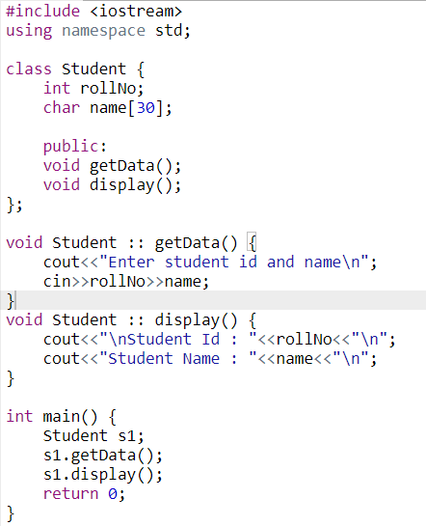
Why Constructors?

Slide 3
Constructors
Special Member function which enables an object to initialize itself when it is created.
Characteristics of Constructors:
Should be declared in public section
Invoked automatically when objects are created
No return type – void, int etc.
Cannot be inherited
Cannot be virtual
No address

Slide 4
Types Of Constructors
Default Constructors
Parameterized Constructors
Copy Constructors

Slide 5
Default Constructors
class integer {
int m,n;
public:
integer();
};
integer :: integer() {
m=0;
n=0;
}
int main() {
integer int1;
return 0;
}

Slide 6
Parameterized Constructors
class integer {
int m,n;
public:
integer(int x, int y);
};
integer :: integer(int x, int y) {
m=x;
n=y;
}
int main() {
integer int1 = integer(0,100); //explicit call
integer int1(2,5); //implicit call
return 0;
}

Slide 7
Copy Constructors
class integer {
int m,n;
public:
integer(int x, int y);
integer(integer &);
};
integer :: integer(int x, int y) {
m=x;
n=y;
}
integer :: integer(integer i) {
m=i.m;
n=i.n;
}
int main() {
integer int1 = integer(0,100); //explicit call
integer int2(int1); //implicit call
return 0;
}

Slide 8
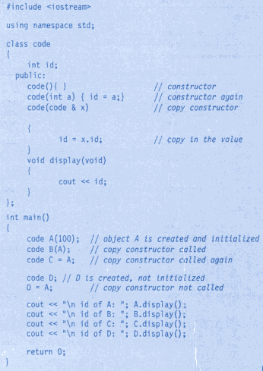
Copy Constructor

Slide 9
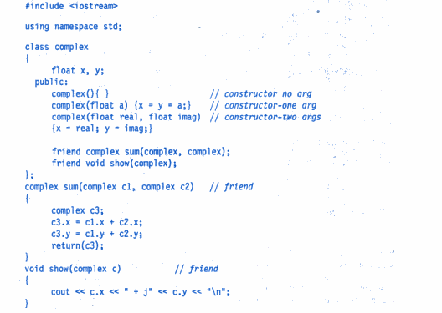
Constructor OverLoading

Slide 10
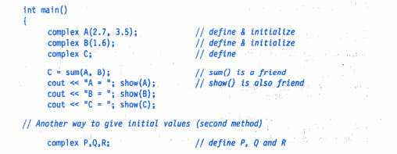
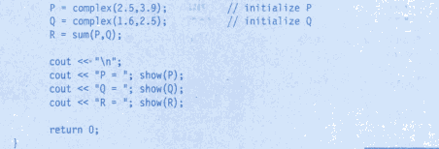
Constructor OverLoading

Slide 11
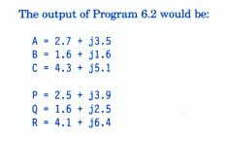
Constructor OverLoading

Slide 12
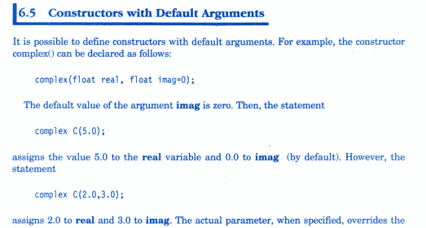
Constructor With Default Arguments

Slide 13
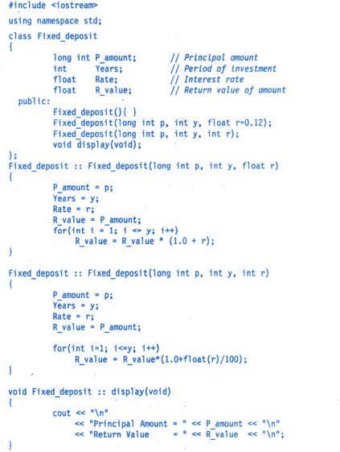

Slide 14
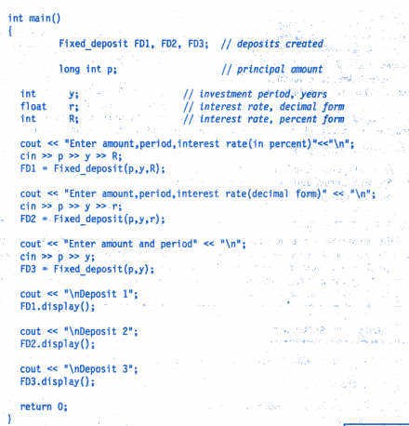

Slide 15
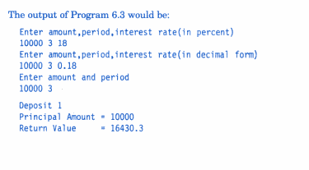
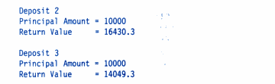

Slide 16
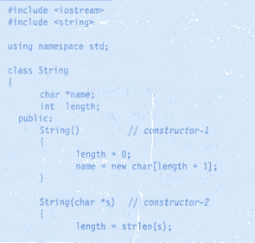
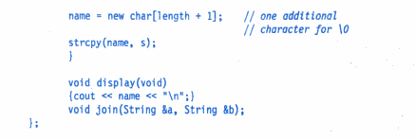
Dynamic Constructor

Slide 17
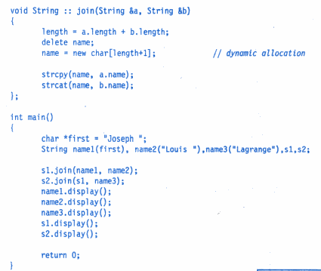
Dynamic Constructor

Slide 18
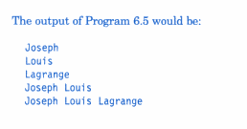
Dynamic Constructor

Slide 19
Destructors
A member function whose name is same as class name but preceded with tilde
e.g. ~integer() { }
used to destroy the object created by a constructor
A destructor never takes any argument nor return a value
delete is used to delete the memory allocated by new()
e.g. matrix ::~matrix()
{
for(int i=0;i<d;i++) {
delete p[i];
delete p;
}

Slide 20
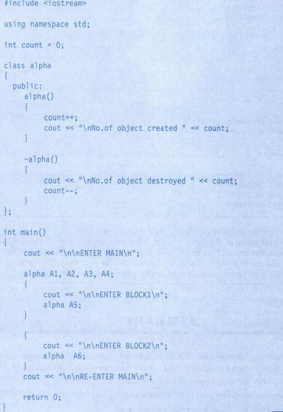

Slide 21
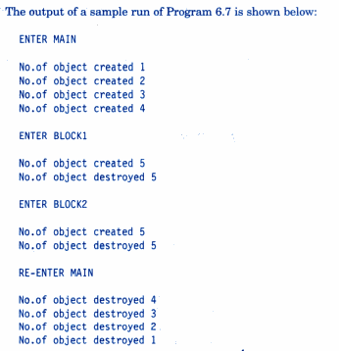

Slide 22
Implementation of Destructors
class test {
static int count = 0;
public:
test() {
count++;
cout<<“In constructor”<<count<<“ \n”;
}
~test() {
cout<<“In destructor “<<count<<“\n”;
count--;
}
};
int main() {
test T1
{
test T2, T3;
}
cout<<“Main block \n”;
}

Slide 23
Using of delete in Destructors
class test {
int *a;
public:
test(int size) {
a = new int[size];
cout<<“Array constructed of size”<<size<<“ \n”;
}
~test() {
delete a;
cout<<“Array destructor \n”;
}
};
int main() {
int s;
cin>>s;
test T(s);
cout<<“Press a key to end program”;
getch();
return 0;
}

